Slide 1
Lesson 3.5
Assessment of Spill Risks
CGPRT(W) : Ensuring Clean Seas and Coasts in Western Region ……

Slide 2
Objective
To understand oil spill risks and potential consequences.
To understand how to evaluate risks and to use results for contingency planning.
CGPRT(W) : Ensuring Clean Seas and Coasts in Western Region ……

Slide 3
Risks Assessment
A proper risks assessment should be the foundation of your contingency plan.
It ensures that your contingency plan is adapted to probable spill scenarios for your area of responsibility.
Risks assessment must answer two questions:
  What is the likelihood of an oil spill?
  What are the potential consequences?
CGPRT(W) : Ensuring Clean Seas and Coasts in Western Region ……

Slide 4
Risk Assessment Process
Analyse hazards and
possible scenarios
Analyse
likelihood
Analyse
consequences
Characterize the risk
Risk
management
Options to
Options to
reduce
reduce
probability
consequences
CGPRT(W) : Ensuring Clean Seas and Coasts in Western Region ……

Slide 5
Risks Assessment Process
What are the hazards?
  Identify potential source
    Many potential sources
    Vessels
      Tankers (size)
      Non-tankers (cargo, RoRo, fishing, etc.)
      Offshore traffic
    Oil handling facilities
      Oil terminal
    Offshore facilities
      Floating Production Storage and Offloading Unit (FPSO)
      Platforms
CGPRT(W) : Ensuring Clean Seas and Coasts in Western Region ……

Slide 6
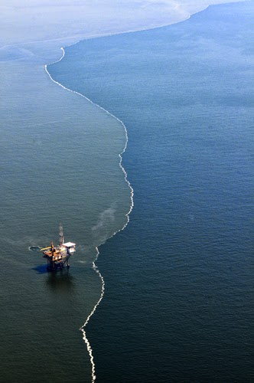
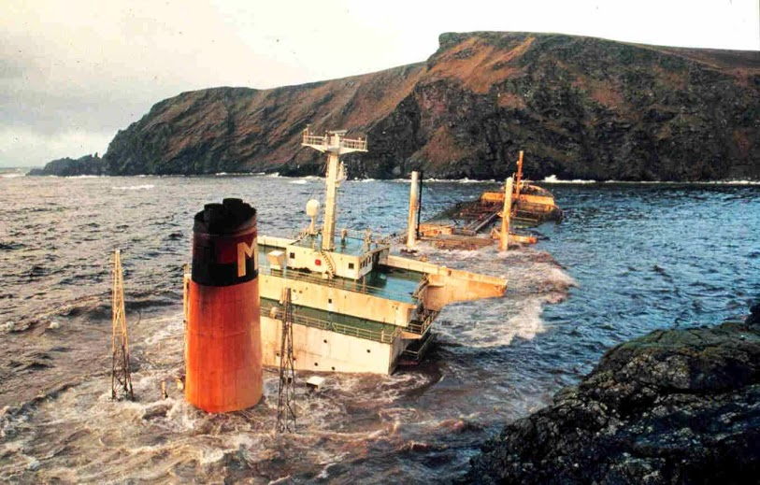
Risk Assessment
CGPRT(W) : Ensuring Clean Seas and Coasts in Western Region ……

Slide 7
Risk Assessment
What is the likelihood of an oil spill?
  Find vessel traffic data
    AIS data
    Major Ports
    Will show areas with high traffic density
  Identify incident types and frequencies
    Grounding, collision, refuelling operations, etc.
    Historical incident data in your area and internationally
CGPRT(W) : Ensuring Clean Seas and Coasts in Western Region ……

Slide 8
Risk Assessment
What is the likelihood of an oil spill?
  Vessel traffic data and incident frequencies will help to identify probabilities for accidents and spills
    Navigational incidents frequency
    Cargo spill frequency
CGPRT(W) : Ensuring Clean Seas and Coasts in Western Region ……

Slide 9
Risk Assessment
What is the likelihood of an oil spill?
This information will help you to build your risks model:
  Identify areas where an oil spill is more likely
  Estimate oil spill frequencies
  Estimate oil spill size
Now, you must estimate potential consequences.
CGPRT(W) : Ensuring Clean Seas and Coasts in Western Region ……

Slide 10
Risk Assessment
What are the potential consequences?
  Identify sensitive resources
    Biological, human, economic
    Use information from sensitivity map
  Identify types and volume of oil transported
    Persistent vs. non persistent oils
    Oil fate and behaviour
  Identify oil spill trajectory
    Using a probable scenario and oil type
    Oil spill modelling
CGPRT(W) : Ensuring Clean Seas and Coasts in Western Region ……

Slide 11
Risk Assessment
What are the potential consequences?
  Estimate effects of oil on impacted sensitive resources
    Effects of oil have been studied over the last 40 years.
    Much information available for various species.
  This information will help you to identify areas that are likely to be impacted by oil and the effects on sensitive resources.
CGPRT(W) : Ensuring Clean Seas and Coasts in Western Region ……

Slide 12
Risk Assessment
What is the risk?
  Integrate information from hazards, spill frequencies and consequences
  Elaboration of a risk matrix
CGPRT(W) : Ensuring Clean Seas and Coasts in Western Region ……

Slide 13
Risk Matrix
 | Consequences
Probability |  | Extreme | Very high | High | Moderate | Low
 | Highly probable
 | Probable
 | Possible
 | Unlikely
 | Improbable
CGPRT(W) : Ensuring Clean Seas and Coasts in Western Region ……

Slide 14
Risk Assessment
What is the risk?
  Is risk acceptable or unacceptable?
  Subjective decision but based on scientific facts
  Involve multiple stakeholders in decision
Risk management
  Identify areas where risks are high, moderate or low;
  Identify measures to reduce likelihood
    Pilotage
    Navigational aids
    Engineering design
    Improved operating procedures
CGPRT(W) : Ensuring Clean Seas and Coasts in Western Region ……

Slide 15
Risk Assessment
Analyse hazards and
possible scenarios
Analyse
likelihood
Analyse
consequences
Characterize the risk
Risk
management
Options to
Options to
reduce
reduce
probability
consequences
CGPRT(W) : Ensuring Clean Seas and Coasts in Western Region ……

Slide 16
Risk Assessment
All risks cannot be eliminated
Adapt your contingency plan to your residual risks
  Appropriate equipment, tiered and commensurate with the risks involved
  Establish incident management system supported by training and exercising
  Response strategies
  Places of refuge
CGPRT(W) : Ensuring Clean Seas and Coasts in Western Region ……

Slide 17
Conclusion
Risk assessment is an essential part of the contingency planning process
The scope and scale of the risk assessment can be adjusted to your needs
  Local
  National
Will ensure that your contingency plan is tailored to the risks you are facing
CGPRT(W) : Ensuring Clean Seas and Coasts in Western Region ……

Slide 18
Any questions?
CGPRT(W) : Ensuring Clean Seas and Coasts in Western Region ……

